Slide 1
CS 106A, Lecture 4 Introduction to Java
suggested reading:
Java Ch. 1, 2.1-2.4, 3.1-3.4

Slide 2
Plan For Today
Announcements
Bye, Karel!
Console Programs
Variables
Expressions
Practice: Receipt

Slide 3
Announcements
Assignment 1 is out on the website!
You must fill out the Honor Code form on the assignment page.
Roomba example
Do on your own if you want!
I will post a YouTube video sometime over the weekend about using the debugger
“Extra” slides: treat these as required reading

Slide 4
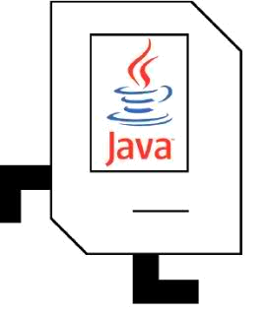
Plan For Today
Announcements
Bye, Karel!
Console Programs
Variables
Expressions
Practice: Receipt

Slide 5

Bye, Karel!
I will miss you.
Enjoy Java!
See you on the midterm

Slide 6
Plan For Today
Announcements
Bye, Karel!
Console Programs
Variables
Expressions
Practice: Receipt

Slide 7
Java
Program
Karel Program
Console Program
Graphics Program
SuperKarel Program

Slide 8
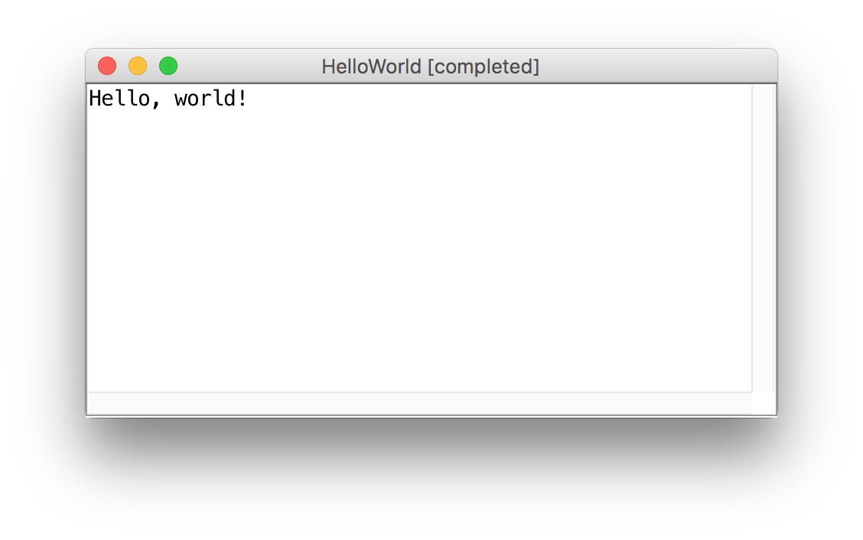
Our First Java Program

Slide 9
Our First Java Program
import acm.program.*;
public class HelloWorld extends ConsoleProgram {
public void run() { println(“Hello, world!”);
}
}

Slide 10
Console Programs
import acm.program.*;
public class Name extends ConsoleProgram {
public void run() {
statements;
}
}
Unlike Karel, many programs produce their behavior as text.
console: Text box into which the behavior is displayed.
output: Messages displayed by the program.
input: Data read by the program that the user types.

Slide 11
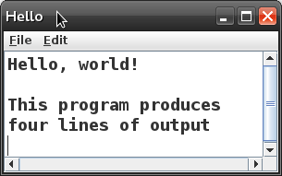
Console Programs
public class Hello extends ConsoleProgram {
public void run() {
println("Hello, world!");
println();
println("This program produces");
println("four lines of output");
}
}

Slide 12
Console Output: println
A statement that prints a line of output on the console, and goes to the next line.
pronounced "print-linn"
Two ways to use println :
println("text");
Prints the given message as output, and goes to the next line.
A message is called a string; it starts/ends with a " quote character.
The quotes do not appear in the output.
A string may not contain a " character.
println();
Prints a blank line of output.

Slide 13
Console I/O
println allows out to output text to the user via the console
Output is the “O” in “I/O”
We can also get input from the user via the console!

Slide 14
Console I/O
println allows out to output text to the user via the console
Output is the “O” in “I/O”
We can also get input from the user via the console!
Before we can receive input from the user, we need a way to store it…

Slide 15
Plan For Today
Announcements
Bye, Karel!
Console Programs
Variables
Expressions
Practice: Receipt

Slide 16
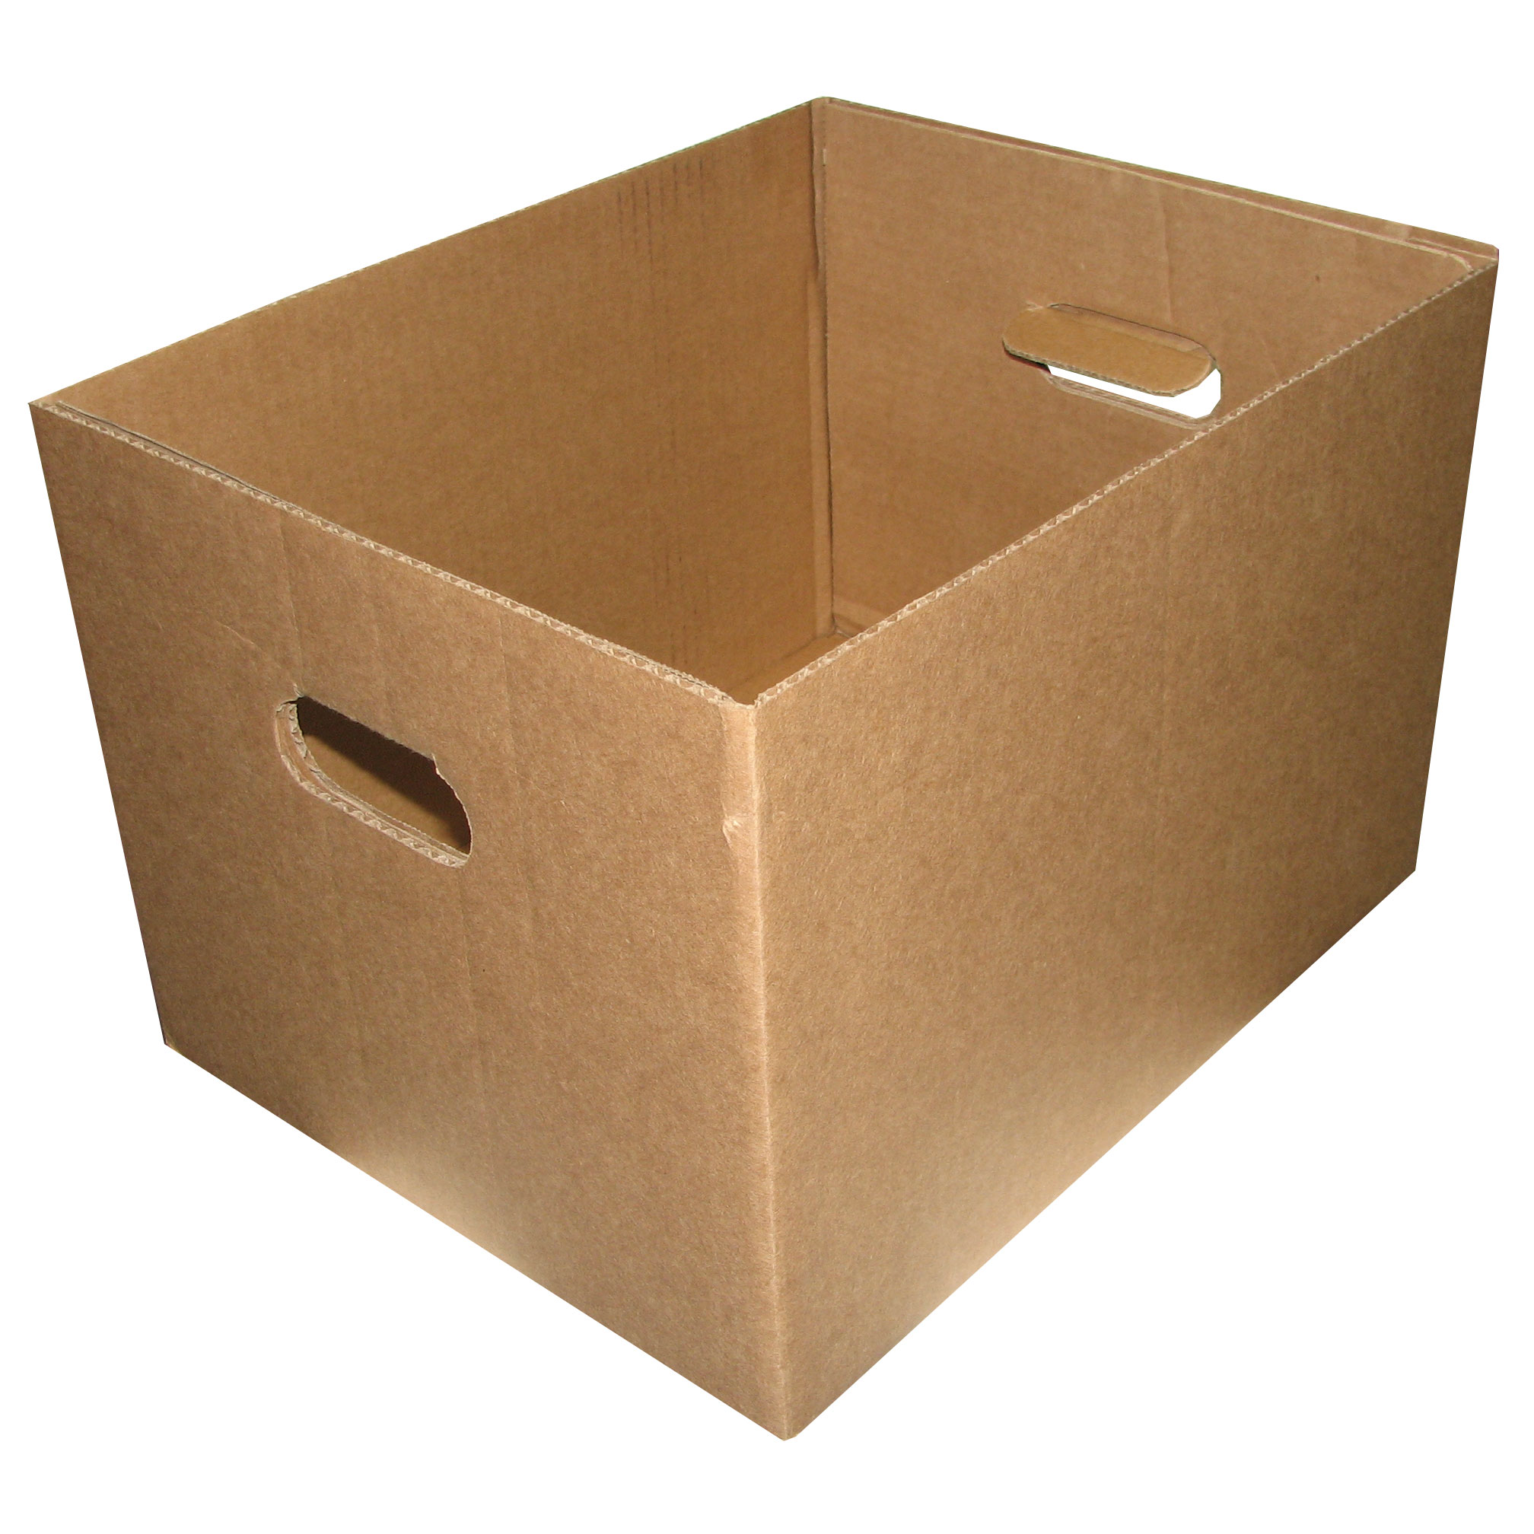
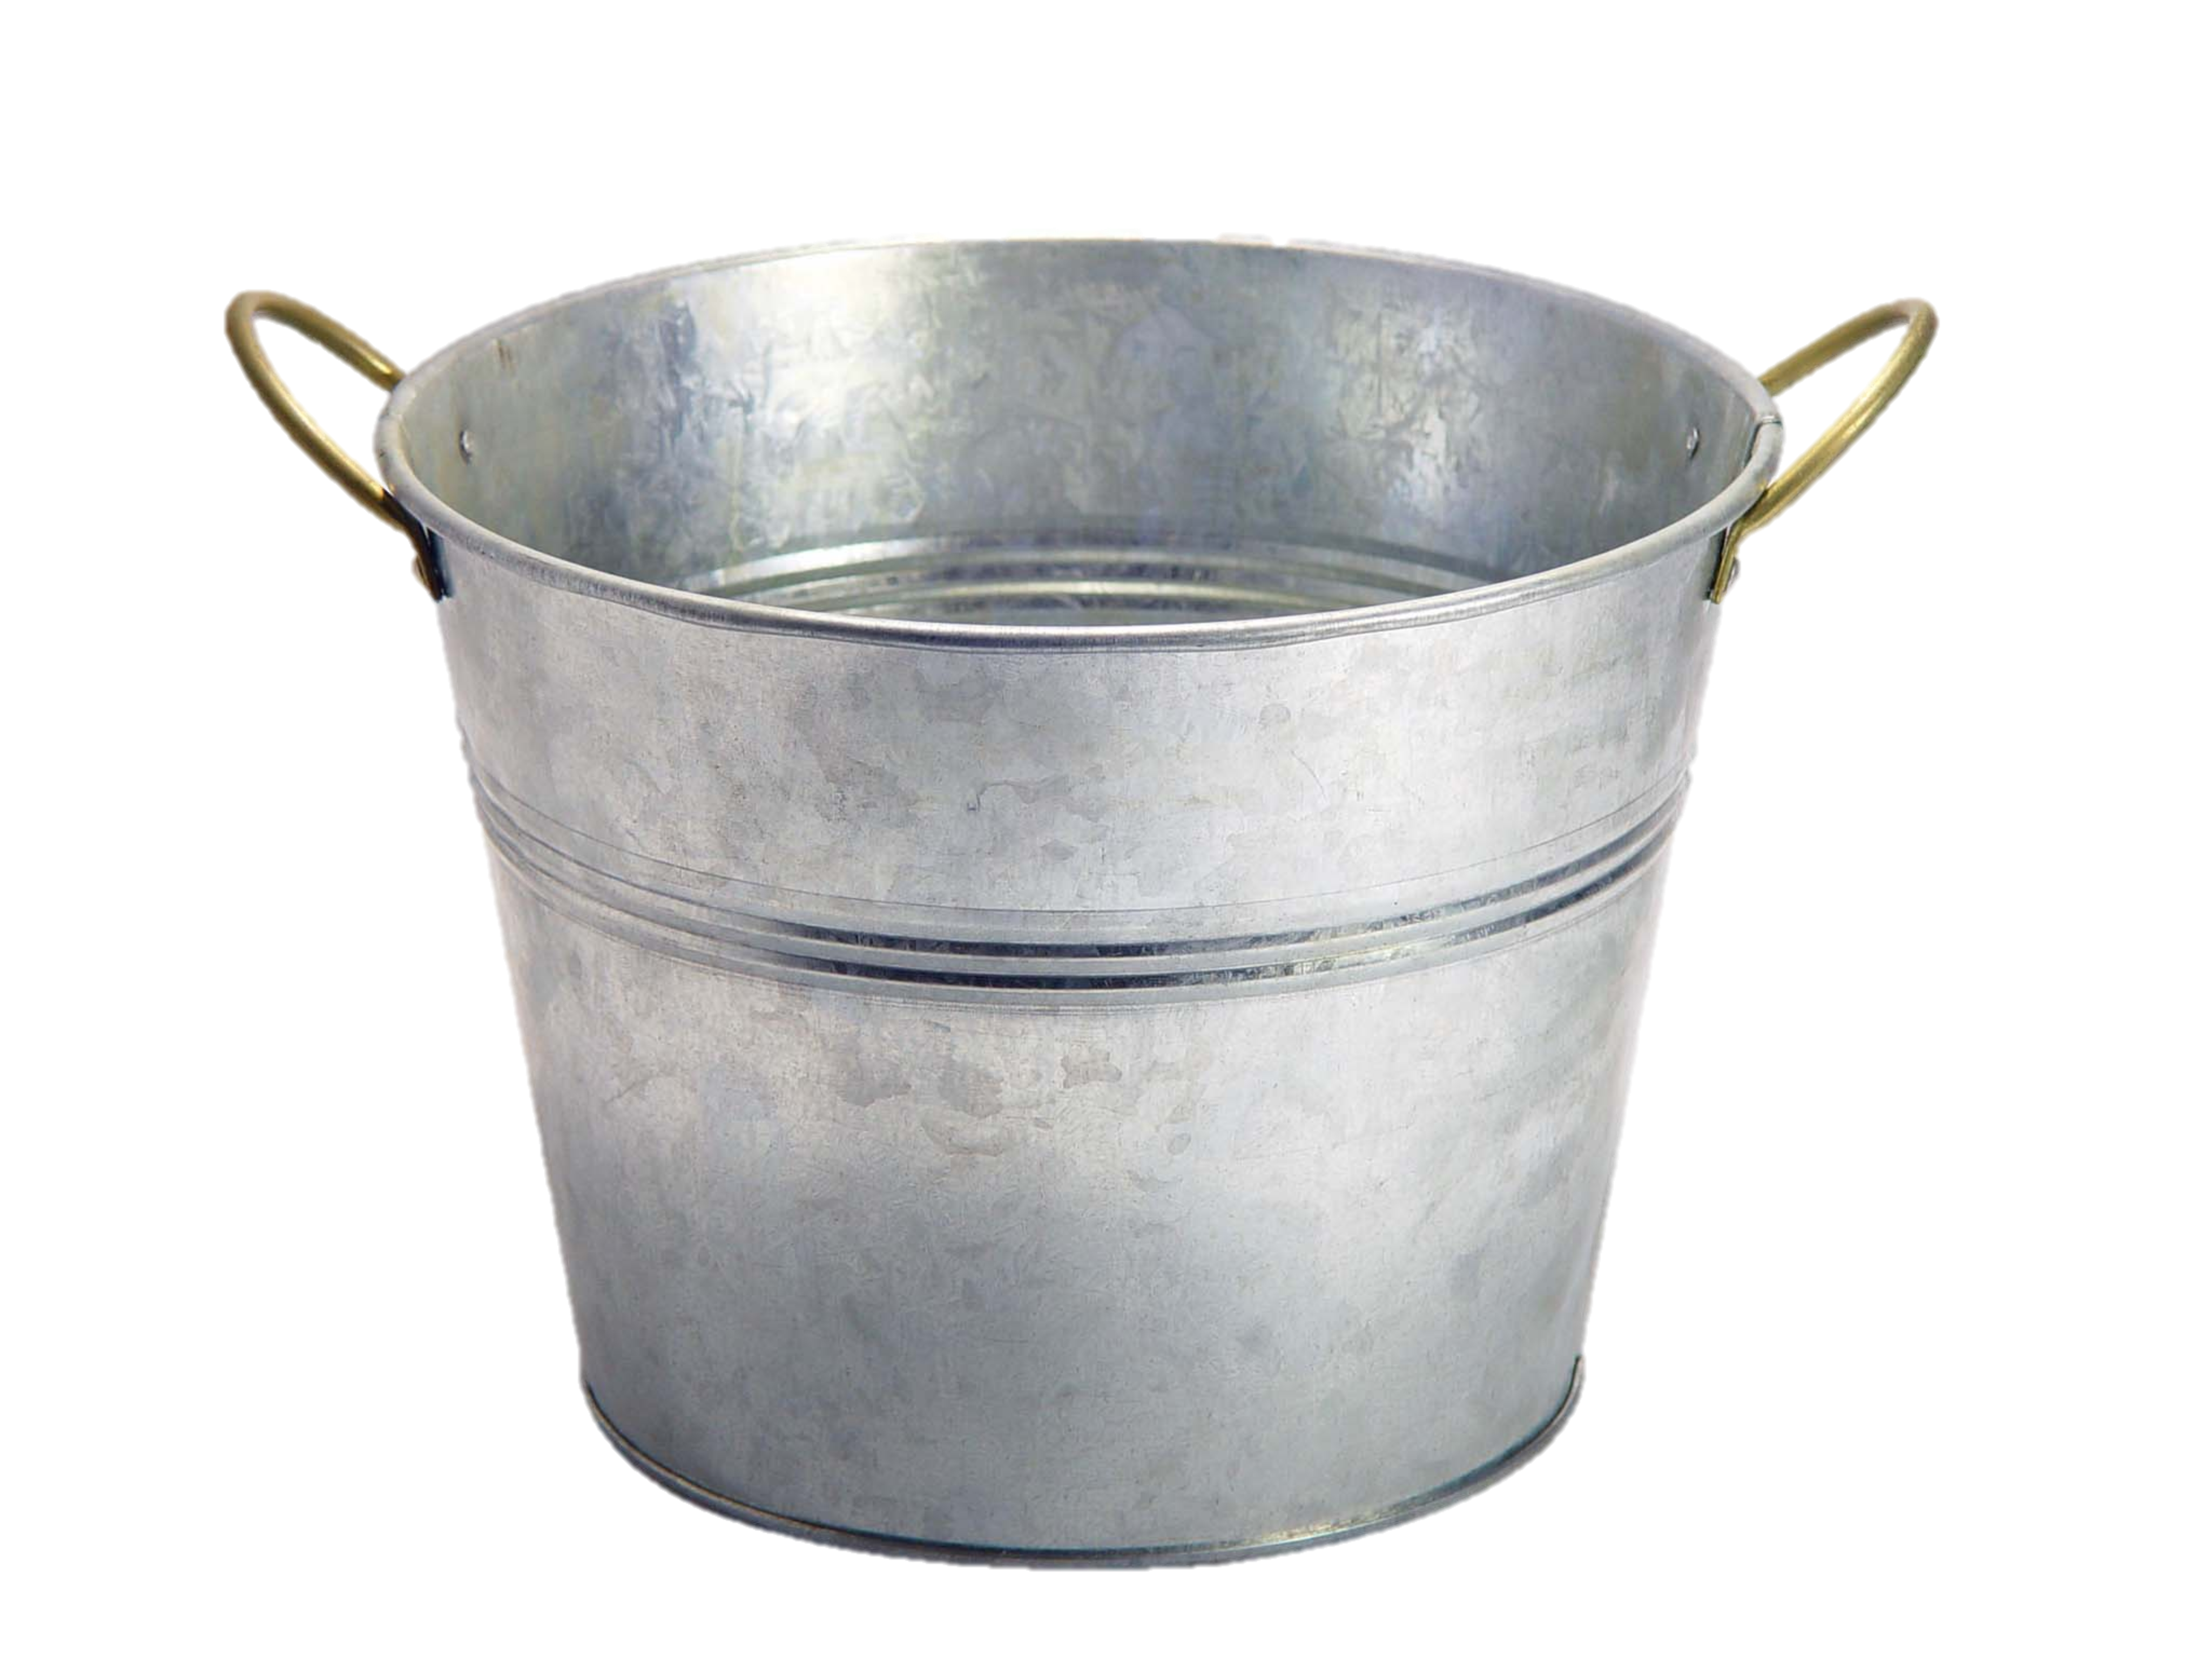
Variables = Boxes

Slide 17
Variables = Boxes
My computer has space for about a billion boxes

Slide 18
Making a new Variable
int myVariable;

Slide 19
Making a new Variable
type
name
int myVariable;

Slide 20
Variable Types
int – an integer number
double – a decimal number
char – a single character
boolean – true or false
Notes:
called primitive types

Slide 21
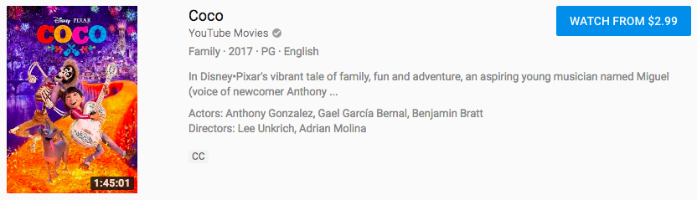
How much does a movie cost?
double – answer is decimal number

Slide 22
How many Teslas in Palo Alto?
int – answer is an integer
Notes:
How much vs how many

Slide 23
double vs. int
How much vs. how many
Notes:
Behavior is slightly different too, we’ll get to that later

Slide 24
Declaration
variable declaration: Sets aside memory for storing a value.
Variables must be declared before they can be used.
Syntax:
type name;
int zipcode;
double myGPA;
zipcode
myGPA
Notes:
we allocate, which just means to set aside

Slide 25
Assignment
value
Existing variable name
myVariable = 2;

Slide 26
Assignment
assignment: Stores a value into a variable.
The value can be an expression; the variable stores its result.
Syntax:
name = expression;
int zipcode;
zipcode = 90210;
double myGPA;
myGPA = 1.0 + 2.25;
zipcode | 90210
myGPA | 3.25
Notes:
thing on right can be whole expression

Slide 27
Assignment
// integer values
int num;
num = 5;
// real values
double fraction;
fraction = 0.2;
// a single letter
char letter;
letter = ‘c’;
// true or false
boolean isLove;
isLove = true;
Notes:
note the single quotes for char
booleans often named started with "is" or "has"
Is what you’re feeling for this class love? Yes!

Slide 28
Declare + initialize
A variable can be declared and initialized in one statement.
This is probably the most commonly used declaration syntax.
Syntax:
type name = expression;
double tempF = 98.6;
int x = (12 / 2) + 3;
tempF | 98.6
x | 9

Slide 29
‘=‘ Means Assignment
Assignment uses = , but it is not an algebraic equation.
= means, "store the value at right in the variable at left"
The right side expression is evaluated first, and then its result is stored in the variable at left.
What happens here?
int x = 3;
x = x + 2; // ???
x | 3
x | 5
Notes:
TARTL: to assign, right to left

Slide 30
Using Variables
Use + to print a string and a variable's value on one line.
double temperature = (95 + 71 + 82.7) / 3.0;
println("The average temp. was " + temperature);
int enrolled = 11 + 17 + 4 + 19 + 14;
println("There are " + enrolled + " students.");
Output:
The average temp. was 82.9
There are 65 students.
Notes:
No quotes!
Confusing because it’s used for multiple things, but this will become natural!

Slide 31
Using Variables
Once given a value, a variable can be used in expressions:
int x = 3;
println(5 * x - 1); // 5 * 3 - 1
You can assign a value more than once:
int x = 3; println(x + " here"); // 3 here x = 4 + 7; println("now x is " + x); // now x is 11
x | 3
x | 11
Notes:
Useful – save the same value and reuse it or change it. Old uses of it don’t change

Slide 32
Assignment and types
A variable can only store a value of its own type.
int x = 2.5; // Error: incompatible types
An int value can be stored in a double variable.
The value is converted into the equivalent real number.
double myGPA = 4;
myGPA | 4.0
Notes:
int doesn't know how to express fraction

Slide 33
Compiler Errors
A variable can't be used until it is assigned a value.
int x;
println(x); // Error: x has no value
You may not declare the same variable twice.
int x;
int x; // ERROR: x already exists
int y = 3;
int y = 5; // Error: y already exists
Notes:
How can we fix this?
y already has a box, and it's a special box that only ints get

Slide 34
Console Input: readInt et al.
// Asks the user for an integer by
// displaying the given message
// and stores it in the variable ’a’
int a = readInt(message);
// Asks the user for a double by
// displaying the given message and
// stores it in the variable ’b’
double b = readDouble(message);
Notes:
finally the original point: getting user input
This will wait for the user to input a number and then continue executing your program

Slide 35

Add2Integers
public class Add2Integers extends ConsoleProgram {
public void run() {
println("This program adds two numbers.");
int n1 = readInt("Enter n1: ");
int n2 = readInt("Enter n2: ");
int total = n1 + n2;
println("The total is " + total + ".");
}
}
n1
n1
n2
n2
total
total
Add2Integers

Slide 36
Add2Integers
public class Add2Integers extends ConsoleProgram {
public void run() {
println("This program adds two numbers.");
int n1 = readInt("Enter n1: ");
int n2 = readInt("Enter n2: ");
int total = n1 + n2;
println("The total is " + total + ".");
}
}
n1
n2
total
Add2Integers

Slide 37
Add2Integers
public class Add2Integers extends ConsoleProgram {
public void run() {
println("This program adds two numbers.");
int n1 = readInt("Enter n1: ");
int n2 = readInt("Enter n2: ");
int total = n1 + n2;
println("The total is " + total + ".");
}
}
n1
n2
total
Add2Integers
This program adds two numbers.
Notes:
Console is down here

Slide 38
Add2Integers
public class Add2Integers extends ConsoleProgram {
public void run() {
println("This program adds two numbers.");
int n1 = readInt("Enter n1: ");
int n2 = readInt("Enter n2: ");
int total = n1 + n2;
println("The total is " + total + ".");
}
}
n1
n2
total
Add2Integers
This program adds two numbers.

Slide 39
Add2Integers
public class Add2Integers extends ConsoleProgram {
public void run() {
println("This program adds two numbers.");
int n1 = readInt("Enter n1: ");
int n2 = readInt("Enter n2: ");
int total = n1 + n2;
println("The total is " + total + ".");
}
}
n1
n2
total
Add2Integers
This program adds two numbers.
Enter n1:
Notes:
First prints out the message

Slide 40
Add2Integers
public class Add2Integers extends ConsoleProgram {
public void run() {
println("This program adds two numbers.");
int n1 = readInt("Enter n1: ");
int n2 = readInt("Enter n2: ");
int total = n1 + n2;
println("The total is " + total + ".");
}
}
n1
n2
total
Add2Integers
This program adds two numbers.
17
Enter n1:
Notes:
Then waits until user enters something

Slide 41
Add2Integers
public class Add2Integers extends ConsoleProgram {
public void run() {
println("This program adds two numbers.");
int n1 = readInt("Enter n1: ");
int n2 = readInt("Enter n2: ");
int total = n1 + n2;
println("The total is " + total + ".");
}
}
n1
n2
total
17
Add2Integers
This program adds two numbers.
17
Enter n1:
Notes:
Then finally assigns the value

Slide 42
Add2Integers
public class Add2Integers extends ConsoleProgram {
public void run() {
println("This program adds two numbers.");
int n1 = readInt("Enter n1: ");
int n2 = readInt("Enter n2: ");
int total = n1 + n2;
println("The total is " + total + ".");
}
}
n1
n2
total
17
Add2Integers
This program adds two numbers.
17
Enter n1:

Slide 43
Add2Integers
public class Add2Integers extends ConsoleProgram {
public void run() {
println("This program adds two numbers.");
int n1 = readInt("Enter n1: ");
int n2 = readInt("Enter n2: ");
int total = n1 + n2;
println("The total is " + total + ".");
}
}
n1
n2
total
17
Add2Integers
This program adds two numbers.
17
Enter n1:
Enter n2:

Slide 44
Add2Integers
public class Add2Integers extends ConsoleProgram {
public void run() {
println("This program adds two numbers.");
int n1 = readInt("Enter n1: ");
int n2 = readInt("Enter n2: ");
int total = n1 + n2;
println("The total is " + total + ".");
}
}
n1
n2
total
17
Add2Integers
This program adds two numbers.
17
Enter n1:
Enter n2:
25

Slide 45
Add2Integers
public class Add2Integers extends ConsoleProgram {
public void run() {
println("This program adds two numbers.");
int n1 = readInt("Enter n1: ");
int n2 = readInt("Enter n2: ");
int total = n1 + n2;
println("The total is " + total + ".");
}
}
n1
n2
total
17
25
Add2Integers
This program adds two numbers.
17
Enter n1:
Enter n2:
25

Slide 46
Add2Integers
public class Add2Integers extends ConsoleProgram {
public void run() {
println("This program adds two numbers.");
int n1 = readInt("Enter n1: ");
int n2 = readInt("Enter n2: ");
int total = n1 + n2;
println("The total is " + total + ".");
}
}
n1
n2
total
17
25
Add2Integers
This program adds two numbers.
17
Enter n1:
Enter n2:
25
Notes:
Declare, evaluate right side, and initialize

Slide 47
Add2Integers
public class Add2Integers extends ConsoleProgram {
public void run() {
println("This program adds two numbers.");
int n1 = readInt("Enter n1: ");
int n2 = readInt("Enter n2: ");
int total = n1 + n2;
println("The total is " + total + ".");
}
}
n1
n2
total
17
25
42
Add2Integers
This program adds two numbers.
17
Enter n1:
Enter n2:
25

Slide 48
Add2Integers
public class Add2Integers extends ConsoleProgram {
public void run() {
println("This program adds two numbers.");
int n1 = readInt("Enter n1: ");
int n2 = readInt("Enter n2: ");
int total = n1 + n2;
println("The total is " + total + ".");
}
}
n1
n2
total
17
25
42
Add2Integers
This program adds two numbers.
17
Enter n1:
Enter n2:
25

Slide 49
Add2Integers
public class Add2Integers extends ConsoleProgram {
public void run() {
println("This program adds two numbers.");
int n1 = readInt("Enter n1: ");
int n2 = readInt("Enter n2: ");
int total = n1 + n2;
println("The total is " + total + ".");
}
}
n1
n2
total
17
25
42
Add2Integers
This program adds two numbers.
17
Enter n1:
Enter n2:
25
The total is 42.

Slide 50
Add2Integers
public class Add2Integers extends ConsoleProgram {
public void run() {
println("This program adds two numbers.");
int n1 = readInt("Enter n1: ");
int n2 = readInt("Enter n2: ");
int total = n1 + n2;
println("The total is " + total + ".");
}
}
n1
n2
total
17
25
42
Add2Integers
This program adds two numbers.
17
Enter n1:
Enter n2:
25
The total is 42.

Slide 51
Plan For Today
Announcements
Bye, Karel!
Console Programs
Variables
Expressions
Practice: Receipt

Slide 52
Expressions
You can combine literals or variables together into expressions using binary operators:
+
Addition
*
Multiplication
–
Subtraction
Division
/
%
Remainder or Mod or Modulus

Slide 53
Integer remainder %
The % operator computes the remainder from integer division.
14 % 4 is 2
218 % 5 is 3 3 43 4 ) 14 5 ) 218 12 20 2 18 15 3
Applications of % operator:
Obtain last digit of a number: 230857 % 10 is 7
Obtain last 4 digits: 658236489 % 10000 is 6489
See whether a number is odd: 7 % 2 is 1, but 42 % 2 is 0
Notes:
Only for integers

Slide 54
What does this do?
println(1 / 2);

Slide 55
What does this do?
println(1 / 2);
0!

Slide 56
Integer division
When we divide integers, the quotient is also an integer.
14 / 4 is 3, not 3.5 . (Java ALWAYS rounds down.)
3 4 52
4 ) 14 10 ) 45 27 ) 1425
12 40 135
2 5 75
54
21
More examples:
32 / 5 is 6
84 / 10 is 8
156 / 100 is 1
Dividing by 0 causes an error when your program runs.

Slide 57
Type Interactions
int and int results in an int
double and double results in a double
int and double results in a double
* The general rule is: operations always return the most expressive type
Notes:
MOST EXPRESSIVE TYPE –you can make an int into a string but not all strings into an int

Slide 58
Type Interactions
Convert 100˚ Celsius temperature to its Fahrenheit equivalent:
double c = 100;
double f = 9 / 5 * c + 32;
The computation consists of evaluating the following expression:
9 / 5 * c + 32
The problem arises from the fact that both 9 and 5 are of type int, which means that the result is also an int.
132
100
1
9 / 5 * c + 32
Notes:
2 terms at a time
How can we fix this?

Slide 59
Pitfalls of Integer Division
You can fix this problem by converting the fraction to a double:
double c = 100;
double f = 9.0 / 5 * c + 32;
The computation now looks like this:
212.0
180.0
1.8
9.0
/ 5 * c + 32
Notes:
2 terms at a time

Slide 60
Plan For Today
Announcements
Bye, Karel!
Console Programs
Variables
Expressions
Practice: Receipt

Slide 61
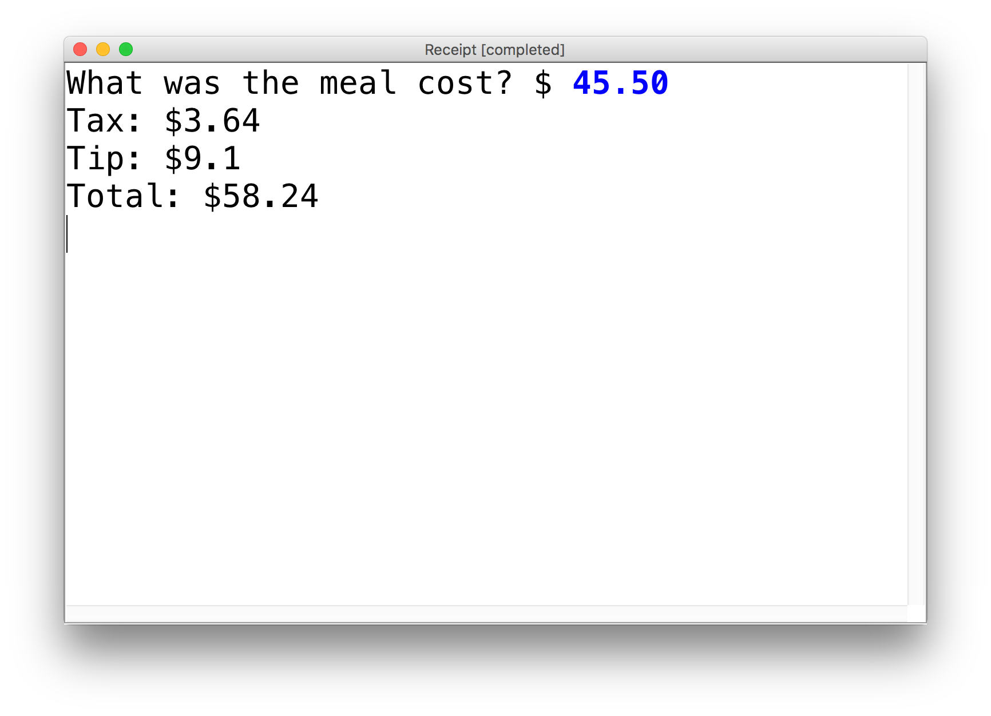
Practice: Receipt Program
Let’s write a ConsoleProgram that calculates the tax, tip and total bill for us at a restaurant.
The program should ask the user for the subtotal, and then calculate and print out the tax, tip and total.

Slide 62
Practice: Receipt Program
public class Receipt extends ConsoleProgram {
public void run() {
double subtotal = readDouble(”Meal cost? $”);
double tax = subtotal * 0.08;
double tip = subtotal * 0.20;
double total = subtotal + tax + tip;
println("Tax: $” + tax);
println("Tip: $” + tip);
println(”Total: $" + total);
}
}

Slide 63
Recap
Announcements
Bye, Karel!
Console Programs
Variables
Expressions
Practice: Receipt
Next time: Control flow in Java

Slide 64
[Extra] Precedence
precedence: Order in which operators are evaluated.
Generally operators evaluate left-to-right. 1 - 2 - 3 is (1 - 2) - 3 which is -4
But * / % have a higher level of precedence than + - 1 + 3 * 4 is 13
6 + 8 / 2 * 3
6 + 4 * 3
6 + 12 is 18
Parentheses can alter order of evaluation, but spacing does not: (1 + 3) * 4 is 16 1+3 * 4-2 is 11

Slide 65
[Extra] String concatenation
string concatenation: Using + between a string and another value to make a longer string.
"hello" + 42 is "hello42"
1 + "abc" + 2 is "1abc2"
"abc" + 1 + 2 is "abc12"
1 + 2 + "abc" is "3abc"
"abc" + 9 * 3 is "abc27"
"1" + 1 is "11"
4 - 1 + "abc" is "3abc"
Use + to print a string and an expression's value together.
println("Average: " + (95.1 + 71.9) / 2);
Output: Average: 83.5
Notes:
There is some other weird behavior with operators…

Slide 66
[Extra] Practice
5 + 3 / 2 - 4
15 / 2.0 + 6
1 * 2 + 3 * 5 % 4
“abc” + 1 + 2
“abc” + (1 + 2)
Notes:
Try with the person next to you!

Slide 67
[Extra] Practice
5 + 3 / 2 - 4 2
15 / 2.0 + 6 13.5
1 * 2 + 3 * 5 % 4 11
“abc” + 1 + 2 "abc12"
“abc” + (1 + 2) "abc3"
Notes:
2
13.5
11
abc12
abc3

Slide 68
[Extra] Precedence examples
1 * 2 + 3 * 5 % 4
“abc” + 1 + 2

Slide 69
[Extra] Precedence examples
1 * 2 + 3 * 5 % 4
\_/ | 2 + 3 * 5 % 4
\_/ | 2 + 15 % 4
\___/ | 2 + 3
\________/ | 5
“abc” + 1 + 2

Slide 70
[Extra] Precedence examples
1 * 2 + 3 * 5 % 4
\_/ | 2 + 3 * 5 % 4
\_/ | 2 + 15 % 4
\___/ | 2 + 3
\________/ | 5
“abc” + 1 + 2
\_/ | “abc1” + 2
\___/ | “abc12”

Slide 71
[Extra] print
public class HelloWorld extends ConsoleProgram {
public void run() {
print("Hello, ");
print("world!");
}
}
Same as println, but does not go to the next line.

Slide 72
[Extra] Escape sequences
escape sequence: A special sequence of characters used to represent certain special characters in a string.
\t tab character
\n new line character
\" quotation mark character
\\ backslash character
Example: println("\\hello\nhow\tare \"you\"?\\\\");
Output: \hello how are "you"?\\

